Slide 1
DAHUA
Mobile Center
Professional Mobile Platform
V2.1.1
www.dahuasecurity.com

Slide 2





CO NTENTS
  New Features
  Overview
  Main Functions
  Highlights
  Sales Strategy
LICENSE / PASSENGER TREND / ALARM ANALYSIS / OPERATION PANEL / HARD DISK FAULT / VIDEO TOUR CONFIG
MOBILE CENTER / TOPOLOGY
SINGLE SERVER / DISTRIBUTE
HOT STANDBY / SYSTEM BACKUP / RECORDS BACKUP
PRODUCT + SERVICE

Slide 3
New Features
/ 01
LICENSE / PASSENGER TREND / ALARM ANALYSIS / OPERATION PANEL / HARD DISK FAULT / VIDEO TOUR CONFIG

Slide 4






New Features | V2.2.1
0 1
0 2
0 3
License
Passenger Trend
Alarm Analysis
0 4
0 5
0 6
Operation Panel
Hard Disk Hitch
Video Tour Config

Slide 5
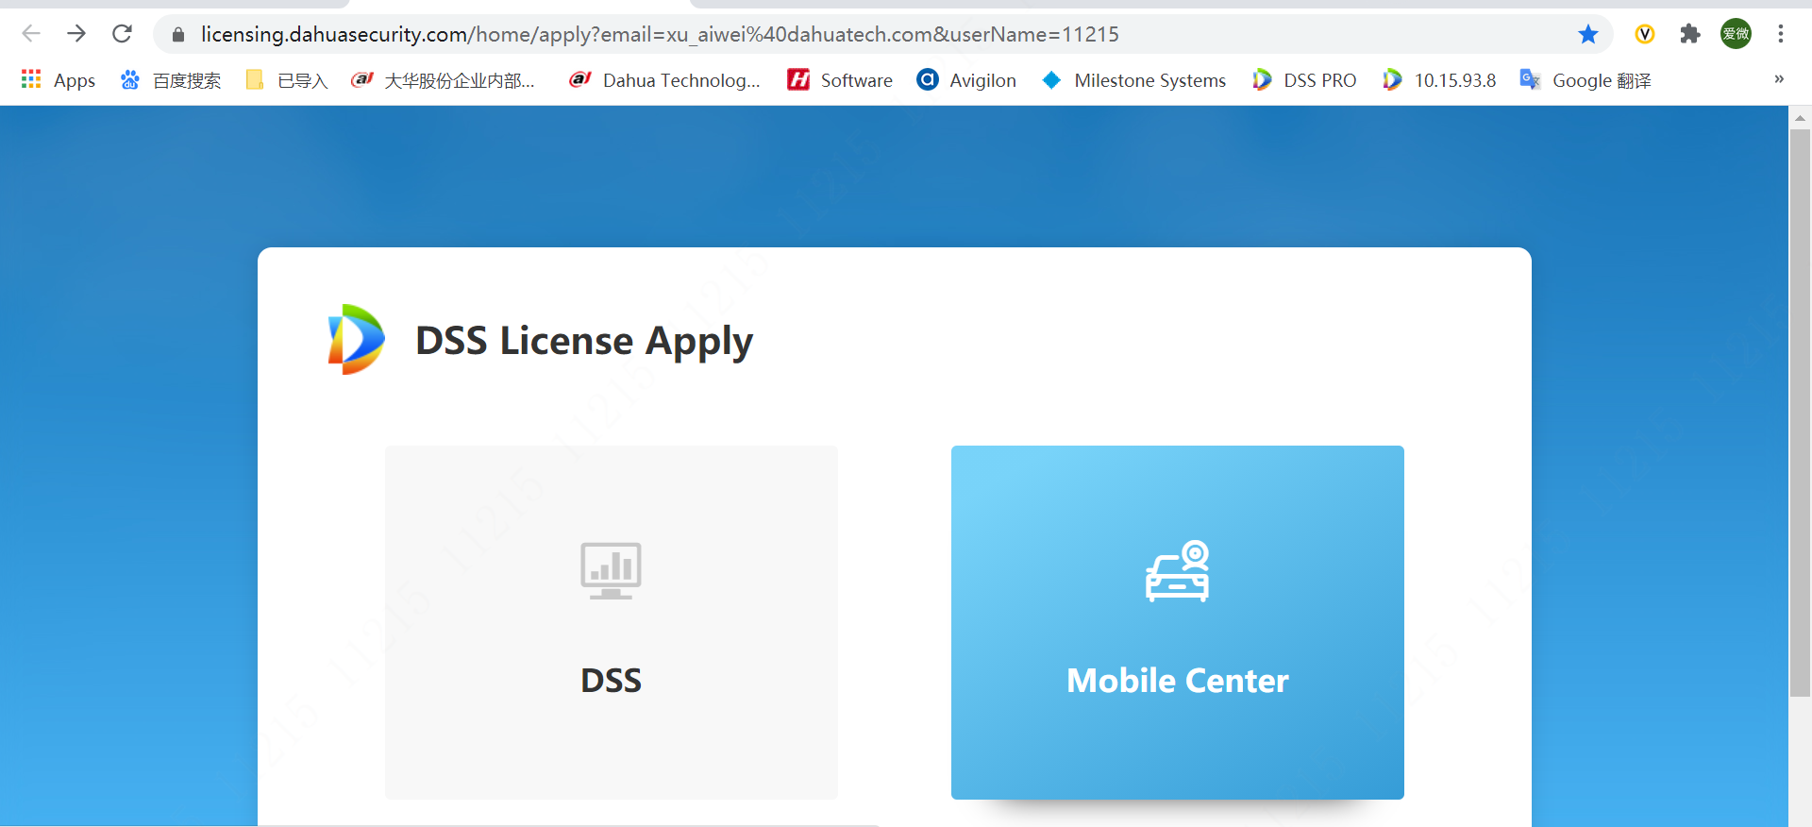
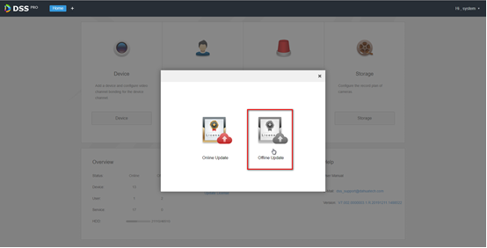
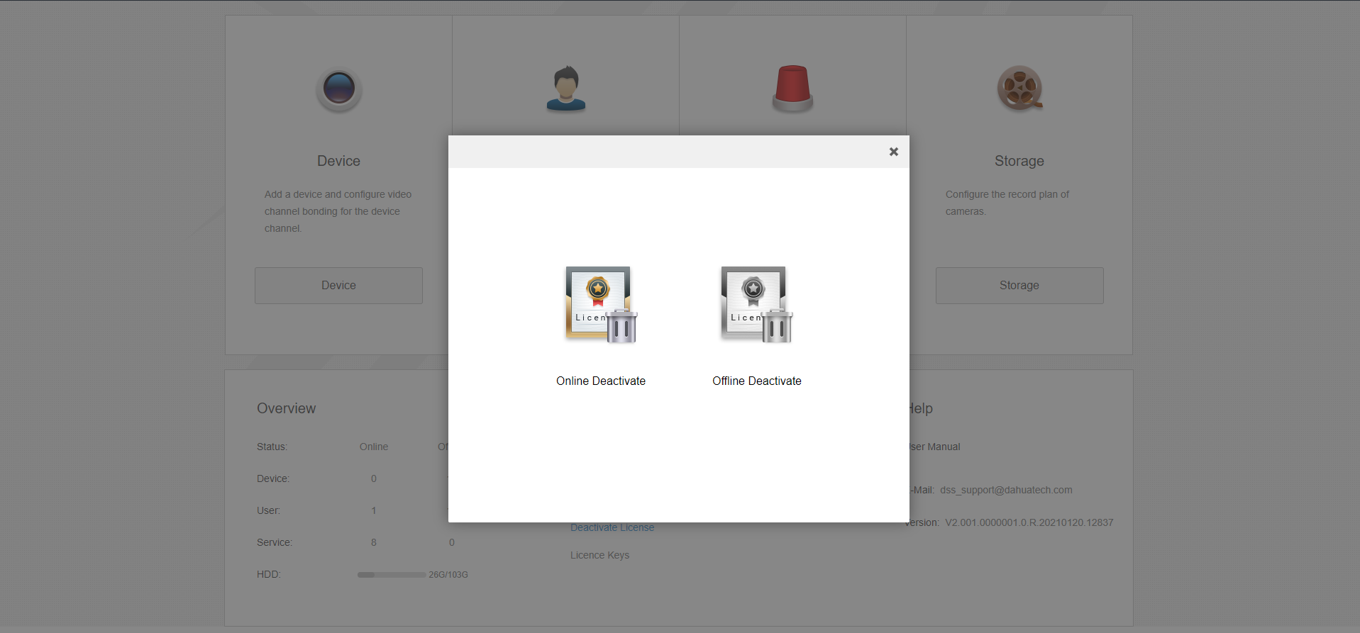
License | Support License Key activation method
Internal employees can apply for a trial through the portal, which is consistent with DSS
After the order is placed, the system will automatically send a notification email
Support online and offline activation methods
Support increase activation
Support deactivation

Slide 6
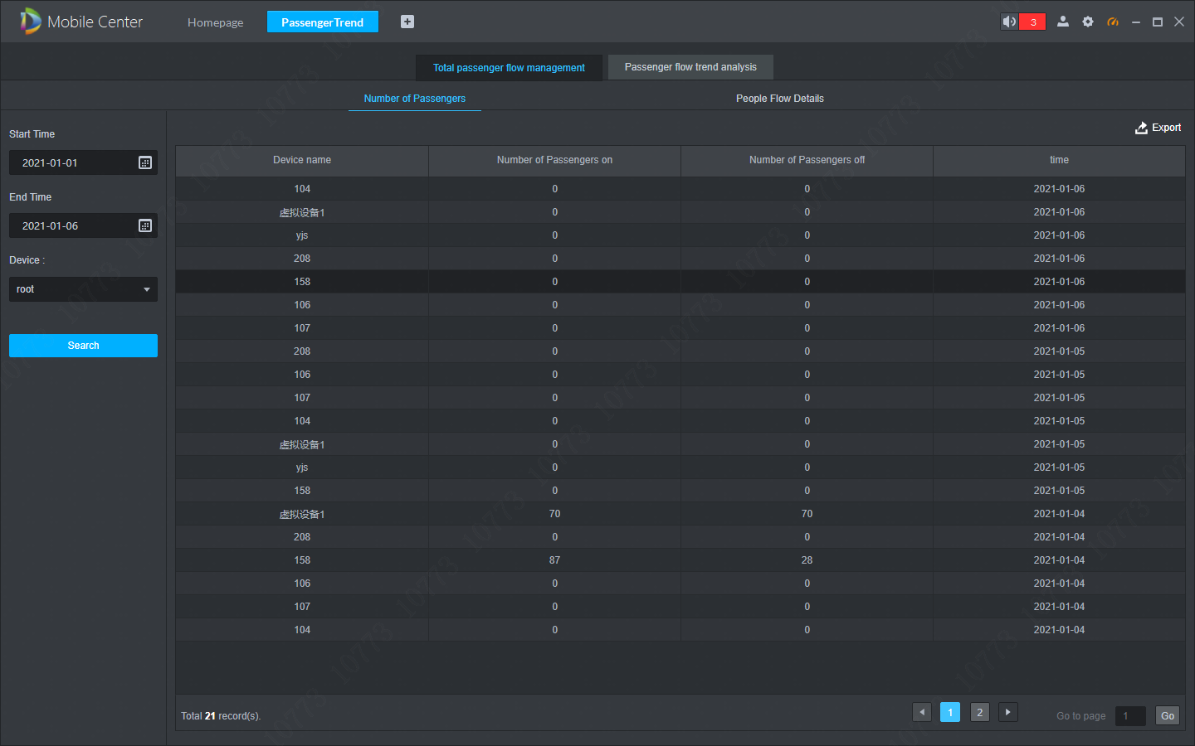
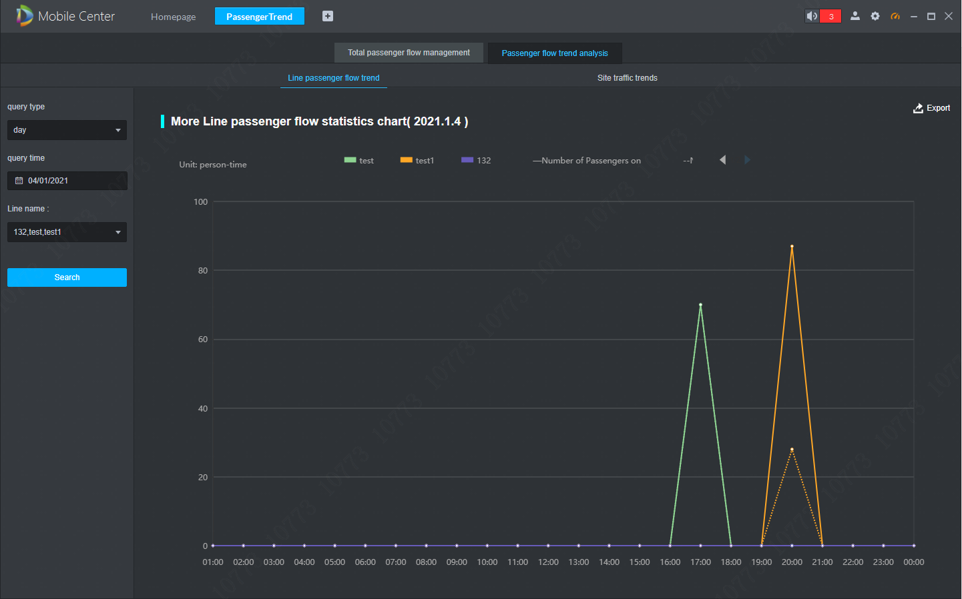
Passenger Flow
Passenger Flow Statistic
Passenger Trend Analysis
Statistic passenger flow according to line or site
Support passenger flow trend analysis
Support query by day, week and month
Support report export
Excluding the data of the current day

Slide 7
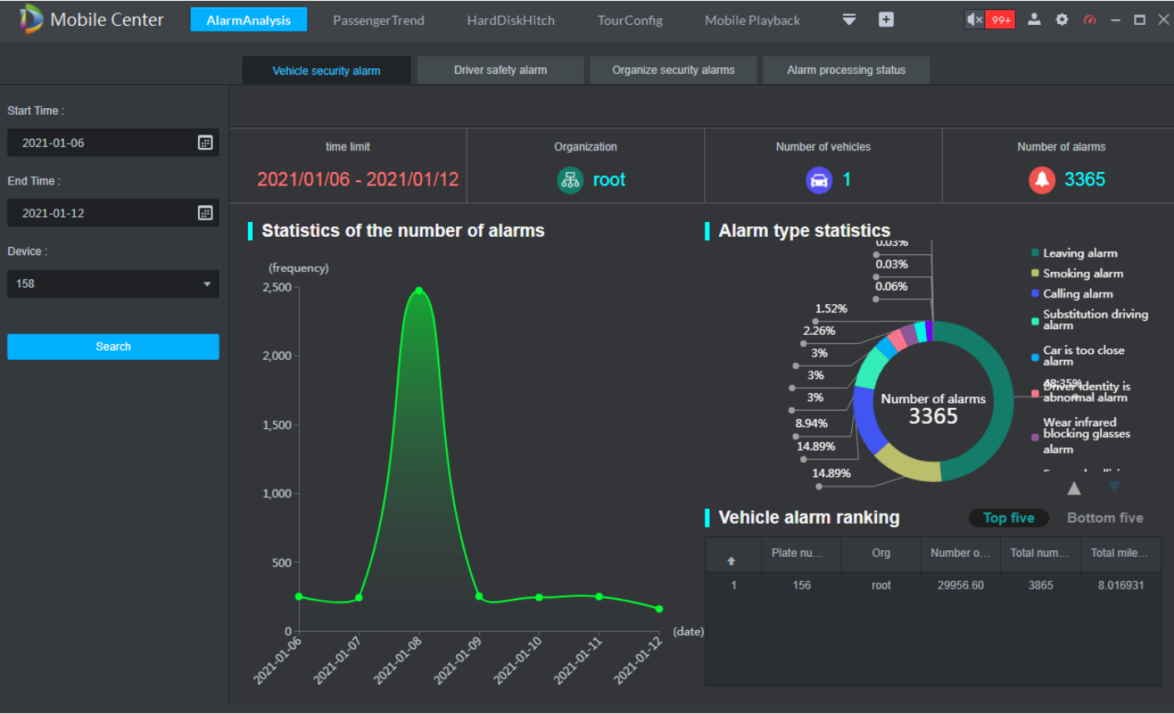
Alarm Analysis
Vehicle security alarm analysis
Drive safety alarm analysis
Analyze the alarm information under the specified organizational structure
Alarm process status analysis
Support analysis by quantity, type, ranking
Alarm Analysis

Slide 8
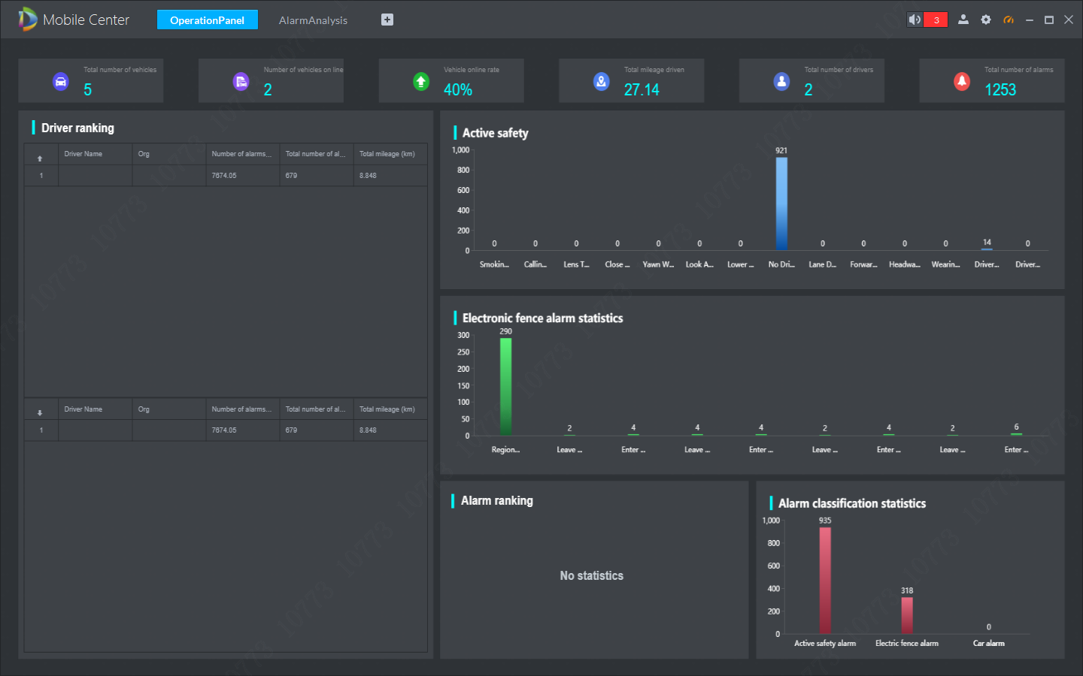
Operation Panel
Multi-dimensional display of vehicle operating status
Statistics can be based on the number of vehicles, online rate, mileage, drivers, total number of alarms, driver rankings, and alarm classifications
Operation Panel

Slide 9
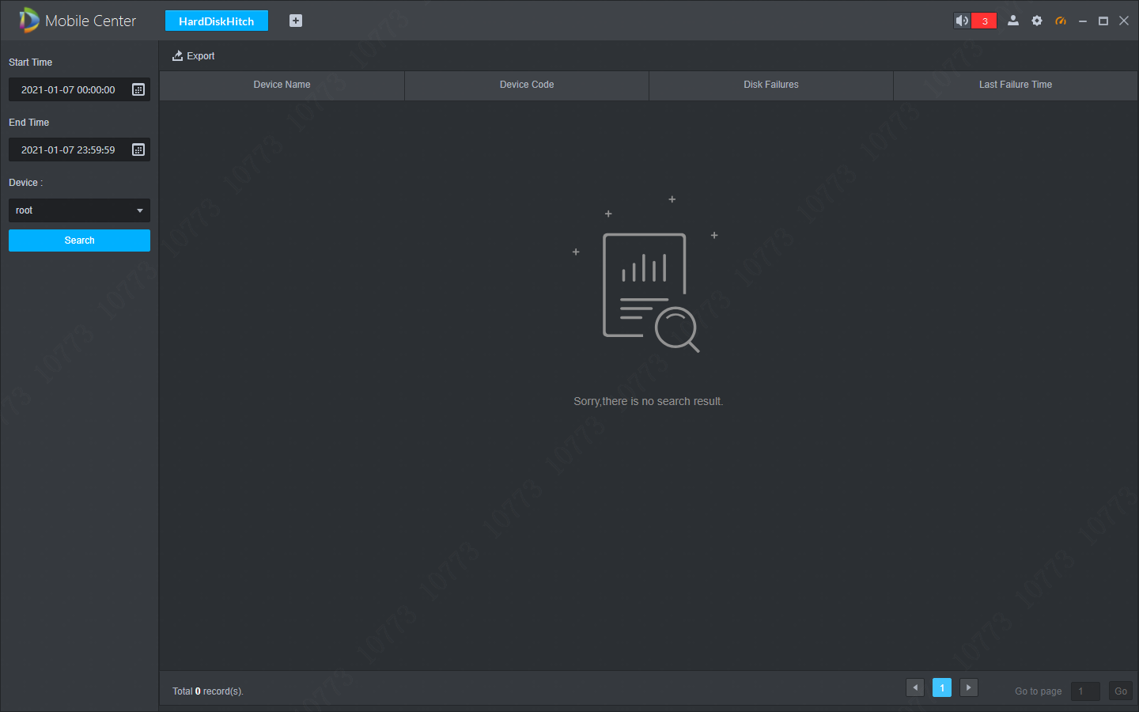
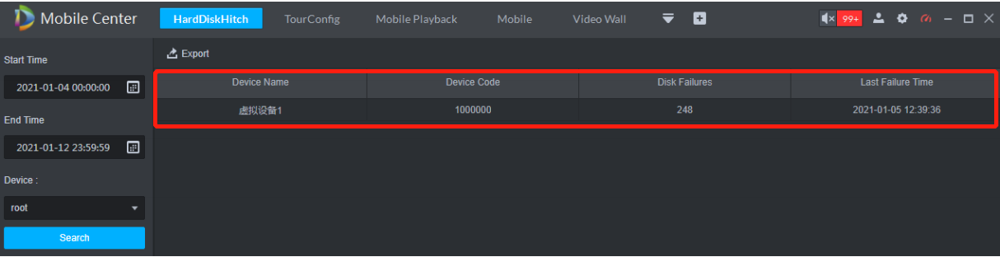

MNVR Hard Disk Hitch
Query the fault information of the MNVR hard disk
Display the device name, device ID, the number of hard disk failures, and the most recent time of occurrence
Hard disk failure information can be exported
Hard Disk Hitch

Slide 10
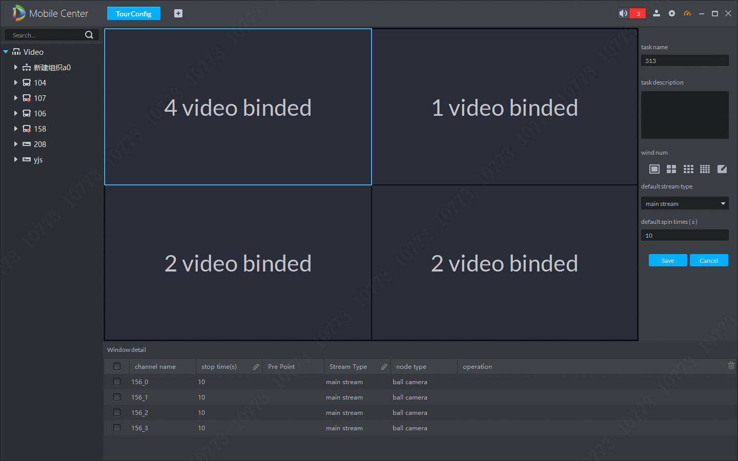
Video Tour Config
Multi-video channel tour in one window in the live view interface
Video channel can be bound
Tour time interval can be set (10 second ~ 12 hours)
One window can be bound with up to 20 video channels
Video Tour Config

Slide 11
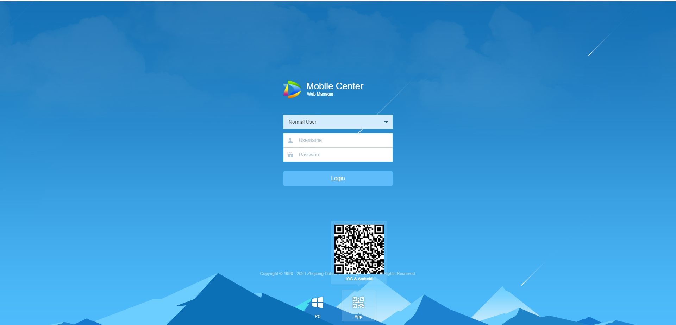

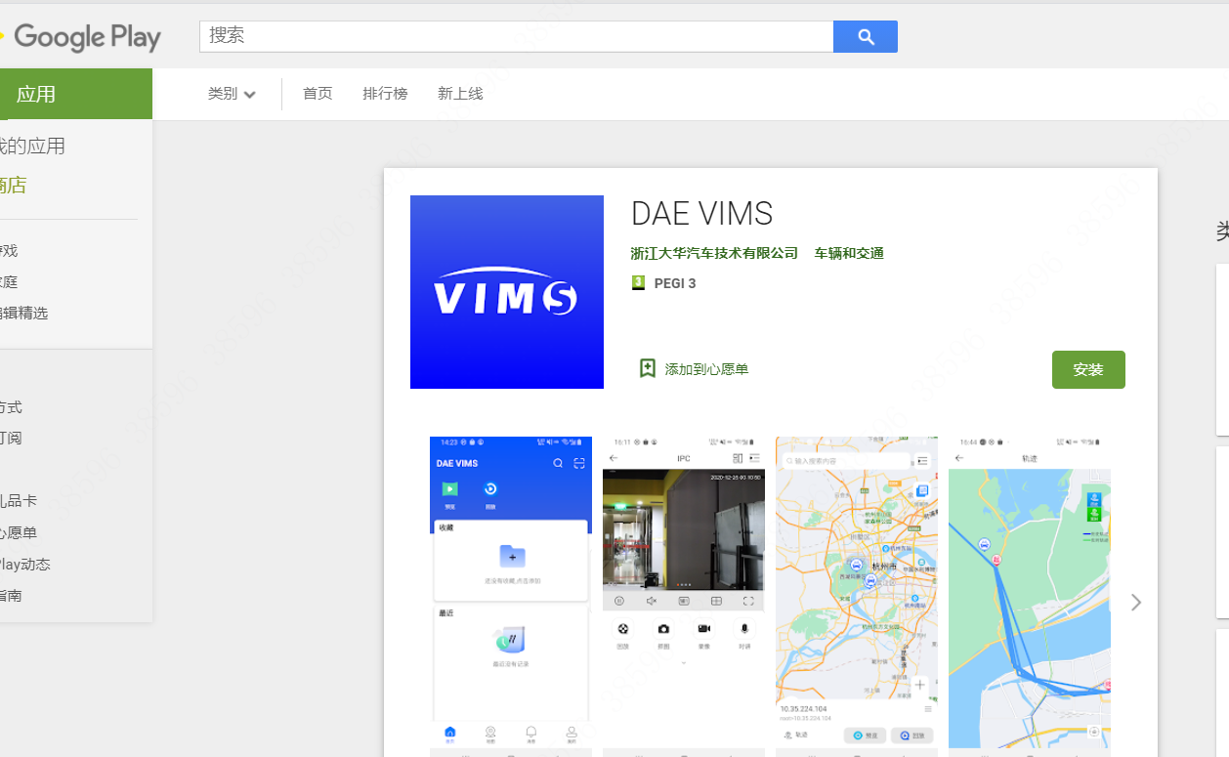


APP | DAE VIMS
Android
IOS

Slide 12
Overview
/ 02
MOBILE CENTER / TOPOLOGY.

Slide 13






Mobile Center
Mobile Center is Dahua’s professional vehicles security management platform. Compatible with Dahua professional mobile devices, such as MNVR/MXVR, the system provide a complete digital solution for vehicle management.
Its core business is central video surveillance, vehicle location management, drive behavior pre-warning, post-event investigation and data statistic analysis etc. Help customer to enrich management methods, improve management efficiency and make better decisions through data analysis.
Core Business
Center Video Monitor
Vehicle Management
Danger Drive Behavior
Investigation
Vehicle Record Statistic
Application
Coach
Bus
School bus
Truck
Taxi
Police vehicle
Notes:
Mobile Center 是专门的车载管理平台，主要配套车载设备使用, 主要针对有批量车辆管理的企业或者部门，比如公交车、物流车辆、校车等。提供一套完整的车辆管理数字化方案。
整个系统的核心业务是：
1.通过视频和电子地图，在监控中心进行车辆状态和视频的监控。
2. 通过电子围栏、主动安全检测和其他传感器等技术手段，规范司机行驶行为，保证行驶安全。
3. 对于异常行为，可进行事后视频和行驶轨迹的调查，有效追责，为管理提供依据。
4. 最后对所有采集的数据进行统计分析，为后期更好的管理决策提供数据支持。
为客户提供有效技术手段、提高管理效率、以及通过数据分析为决策做依据。

Slide 14

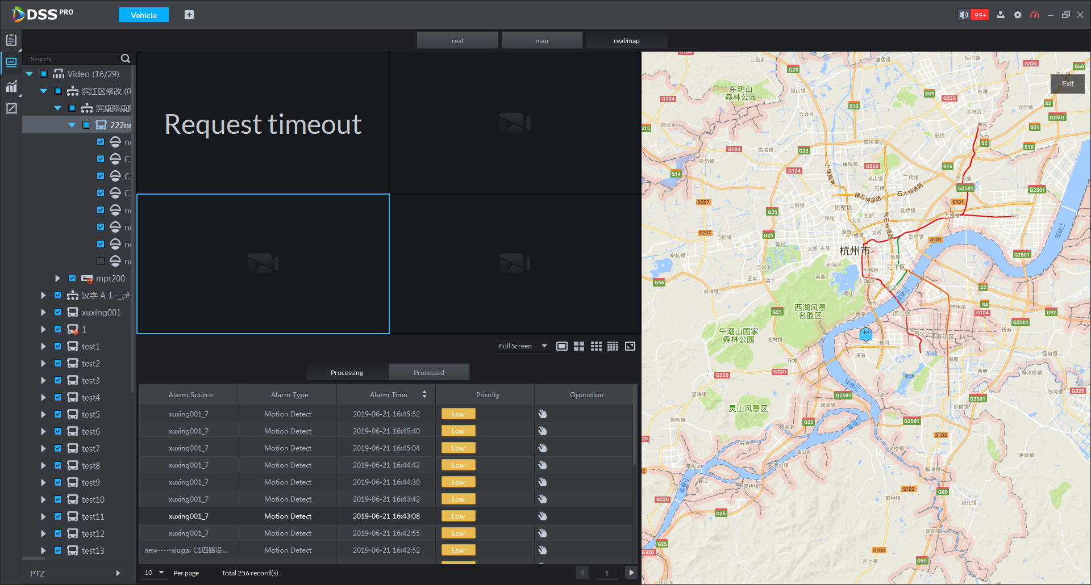

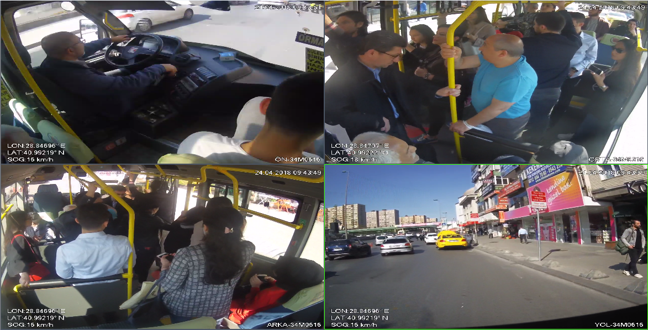
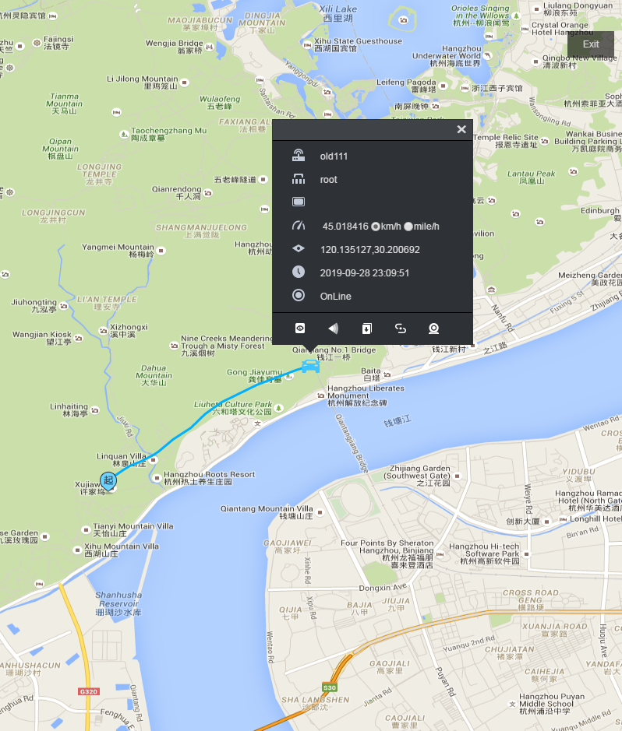


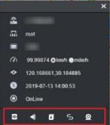
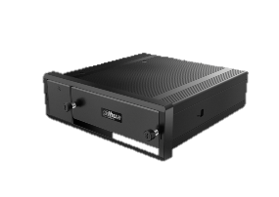



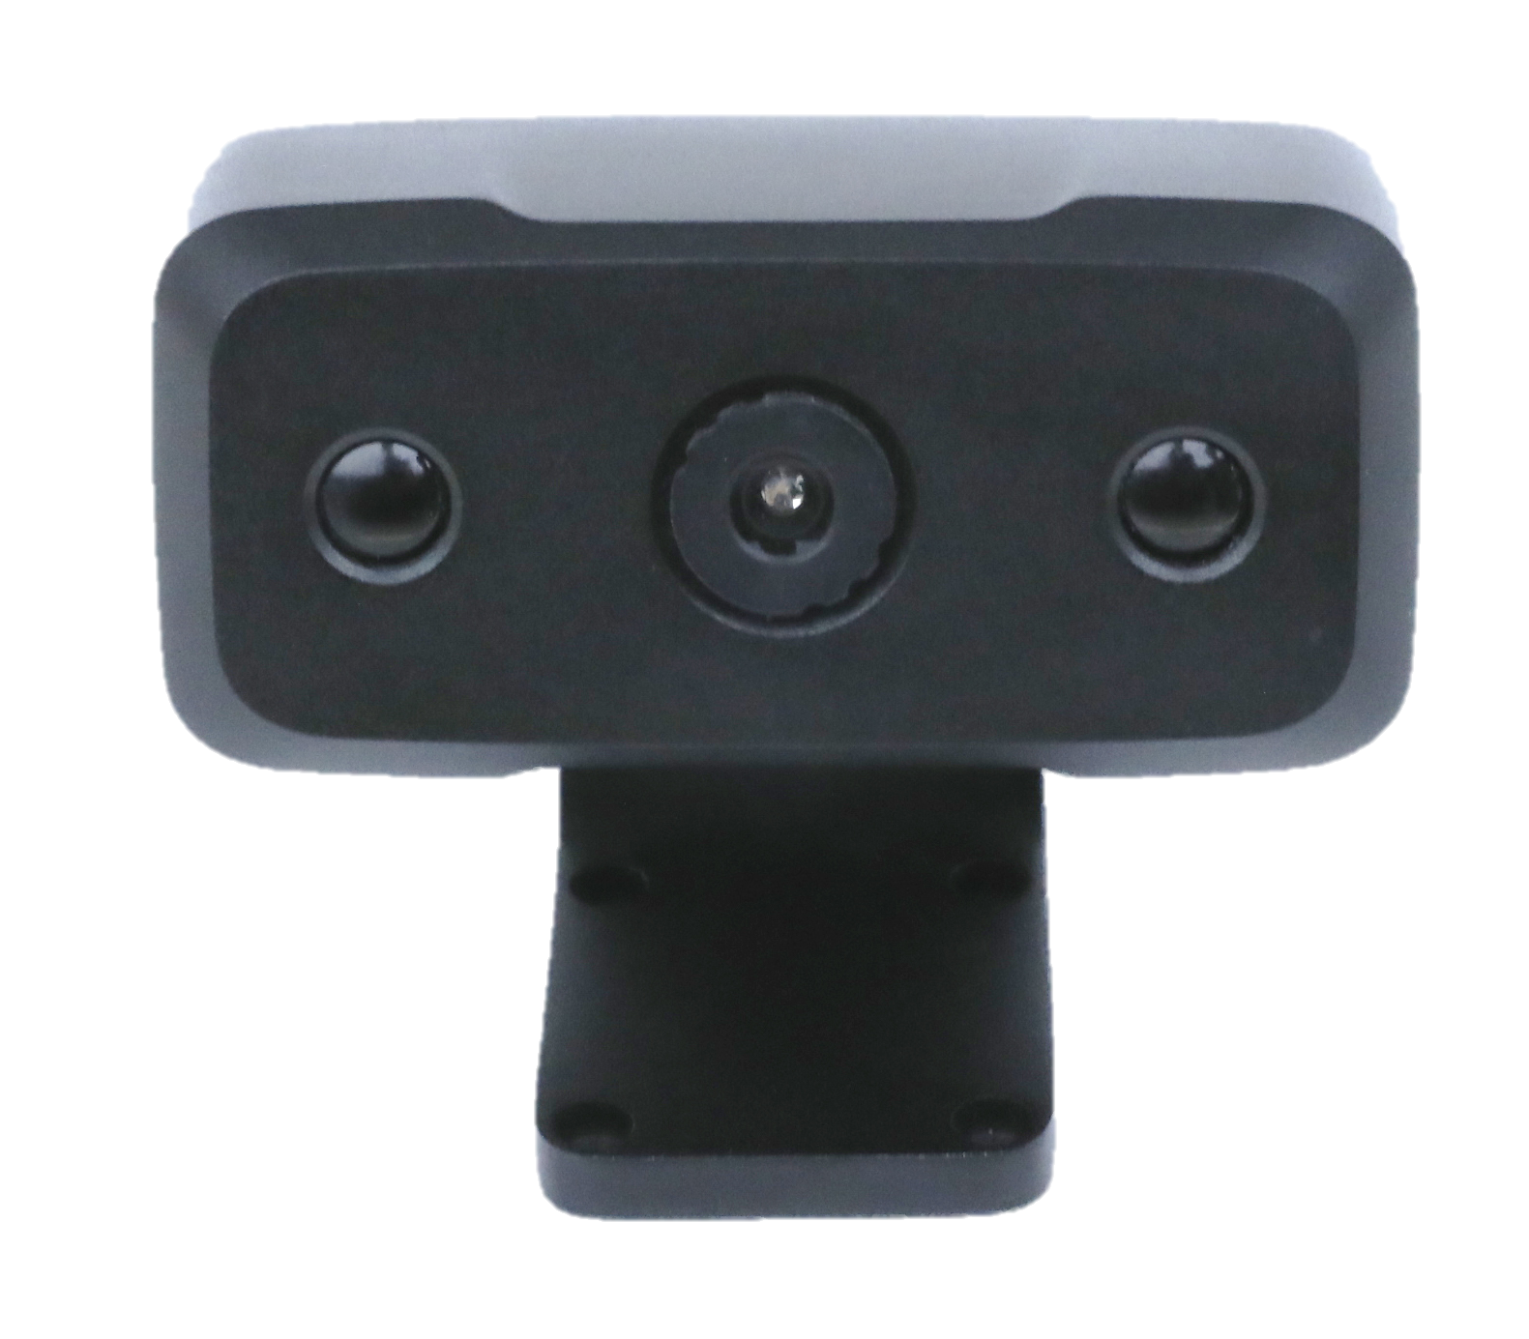
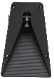



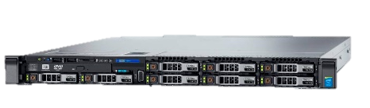

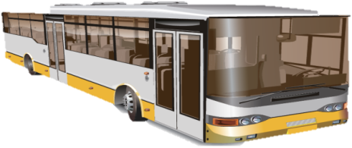

Topology
Surveillance Centre
Onboard
GPS
MNVR
3G/4G
Display
WAN
Video Wall
Emergency button
M70
Storage
Client
Camera
DSM
ADAS
Mobile center
Base Station
) ) ) )
WIFI
Switch

Slide 15
Main Functions
/ 03
MNVR CONFIG / REMOTE UPGRADE / ACTIVE SAFETY / MONITOR CENTER

Slide 16
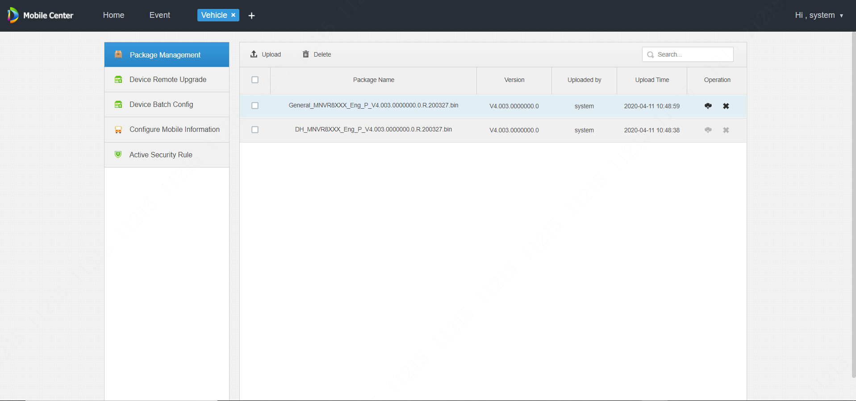
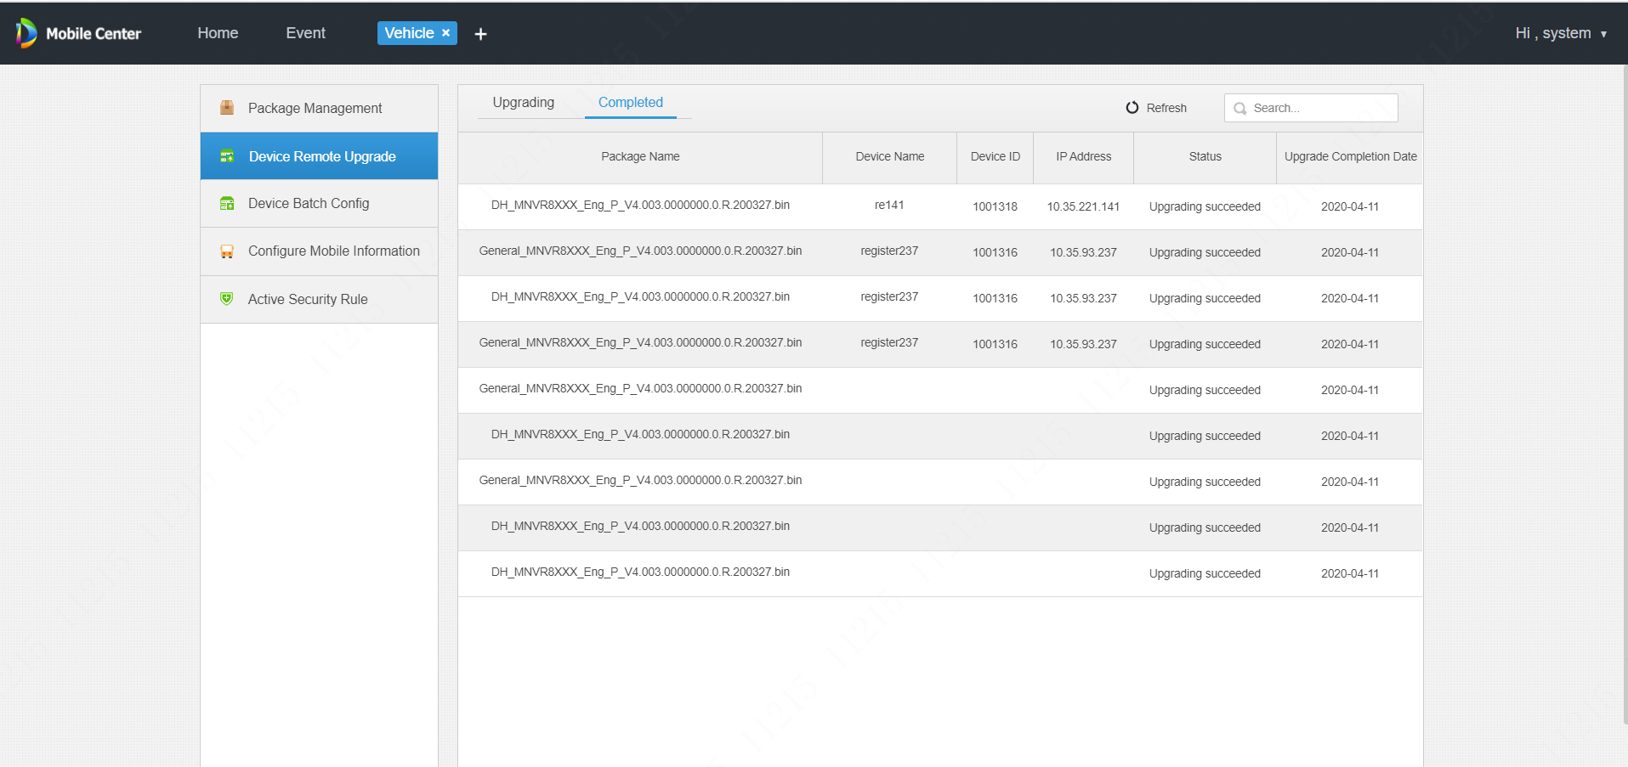
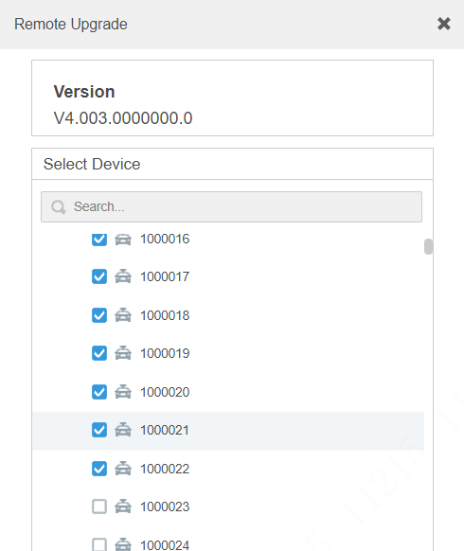
Easily device management | Remote Upgrade Firmware
Manage the MNVR firmware，
and remote upgrade in batches.
Visualize the progress of the upgrade,
upgrading or completed.
Notes:
MNVR一般安装在车辆上，设备非常分散，往往要花很多精力在设备的配置和升级上。

Slide 17
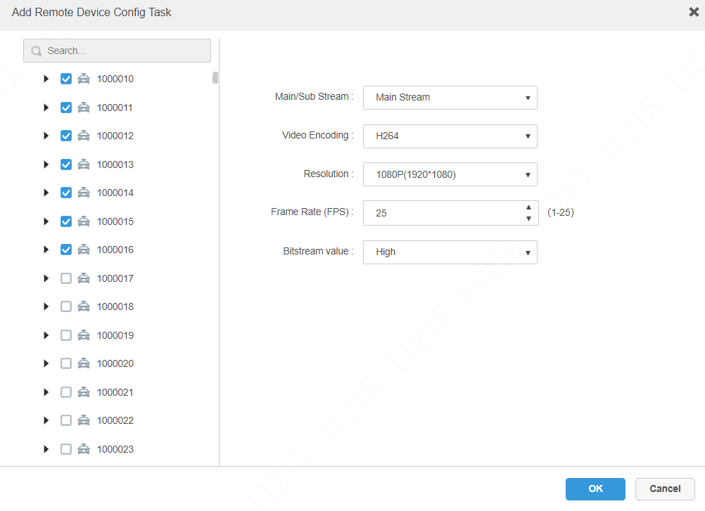
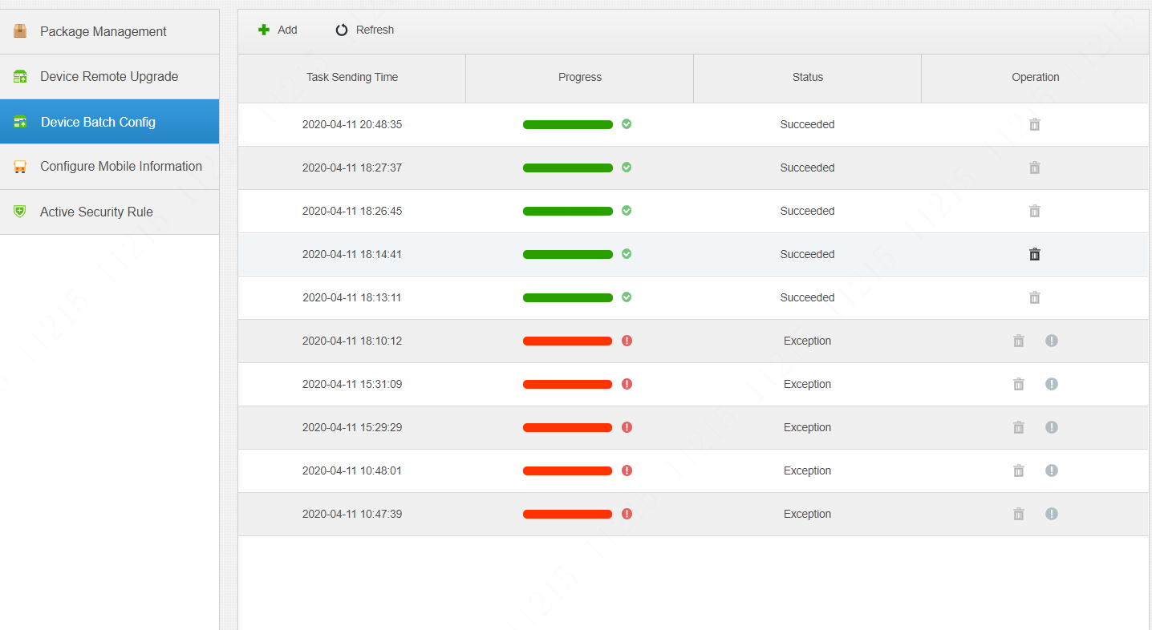
Easily system deployment| Batch device configuration
Encode Parameters
Remotely configure the encode parameters of MNVR, it supports batch configuration.
Displays the results, succeeded or exception.
Notes:
MNVR一般安装在车辆上，设备非常分散，往往要花很多精力在设备的配置和升级上。

Slide 18
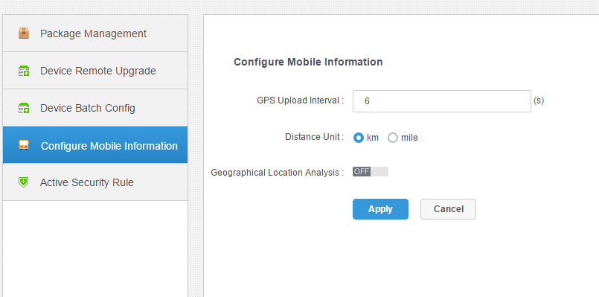
Other Configuration
Others
GPS upload interval configurable （6-60s）
Distance unit configurable （km 、mile）
Geographical location analysis（Extra purchase, free version and limited access）
Notes:
GPS: 控制上传频率，考虑数据库

Slide 19
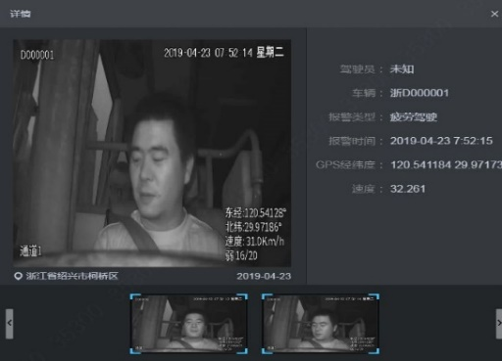
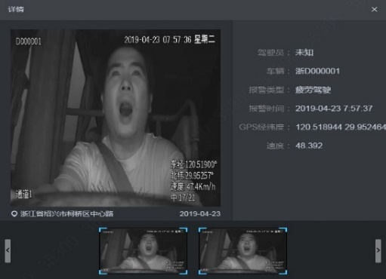
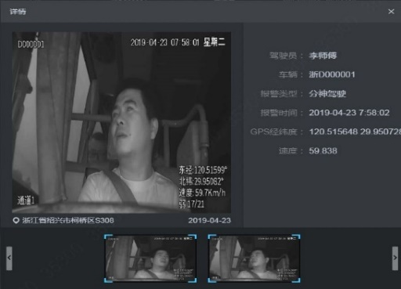
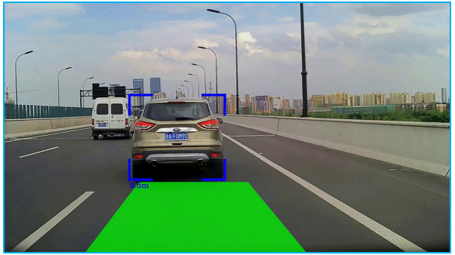
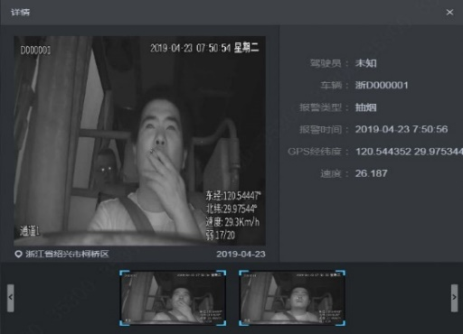
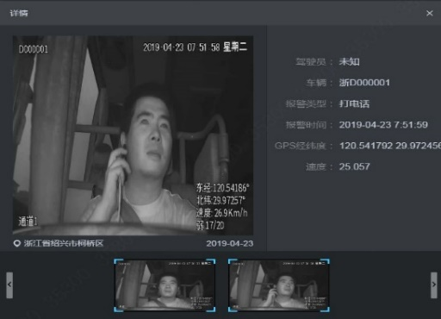
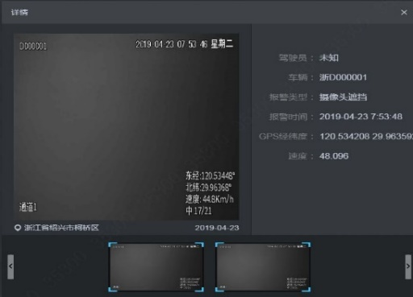
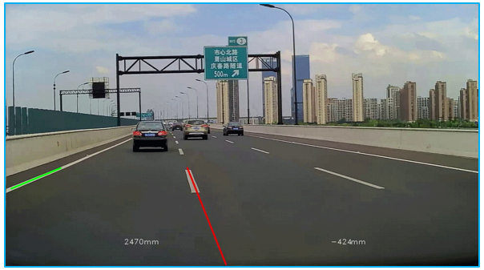
Active Safety management
DMS
ADAS
Drowsy driving
Distracted driving
Forward collision warning
Smoking/Calling
Lens tampering
Lane departure warning
Active prevention
When these behaviors happen, system will warn the driver and upload the alarm to the control center as evidence，eventually to decrease accidents.

Slide 20
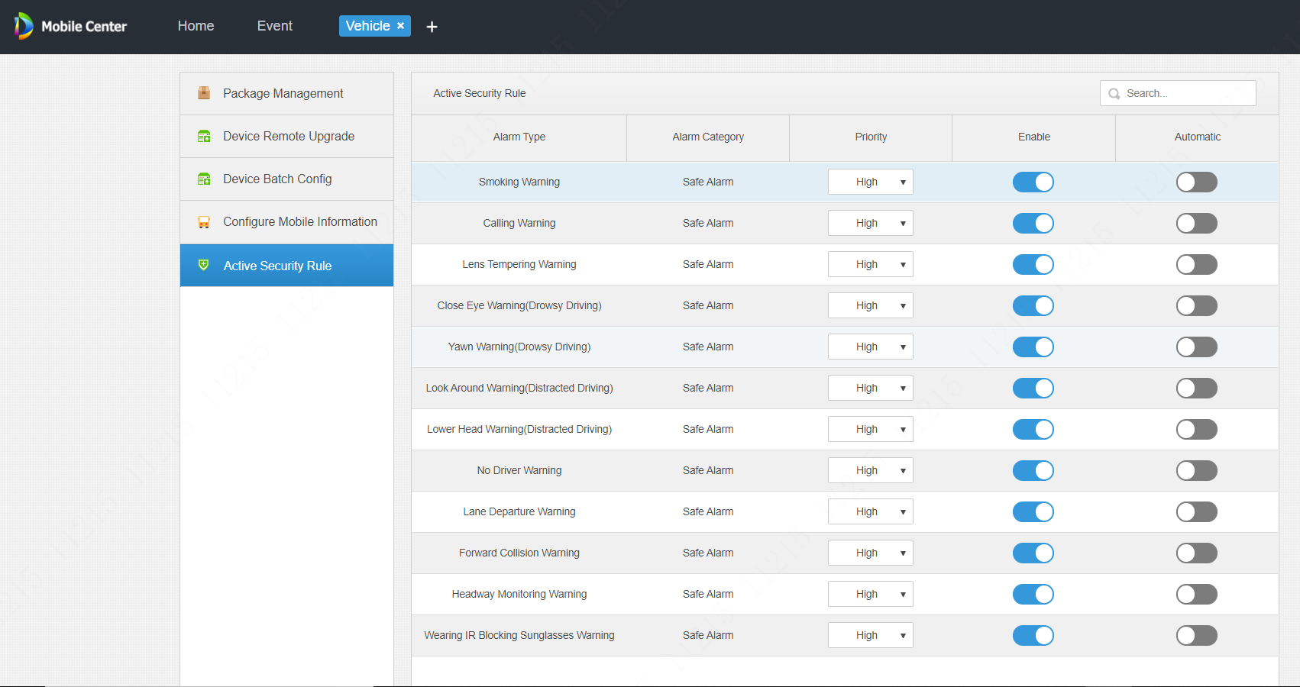
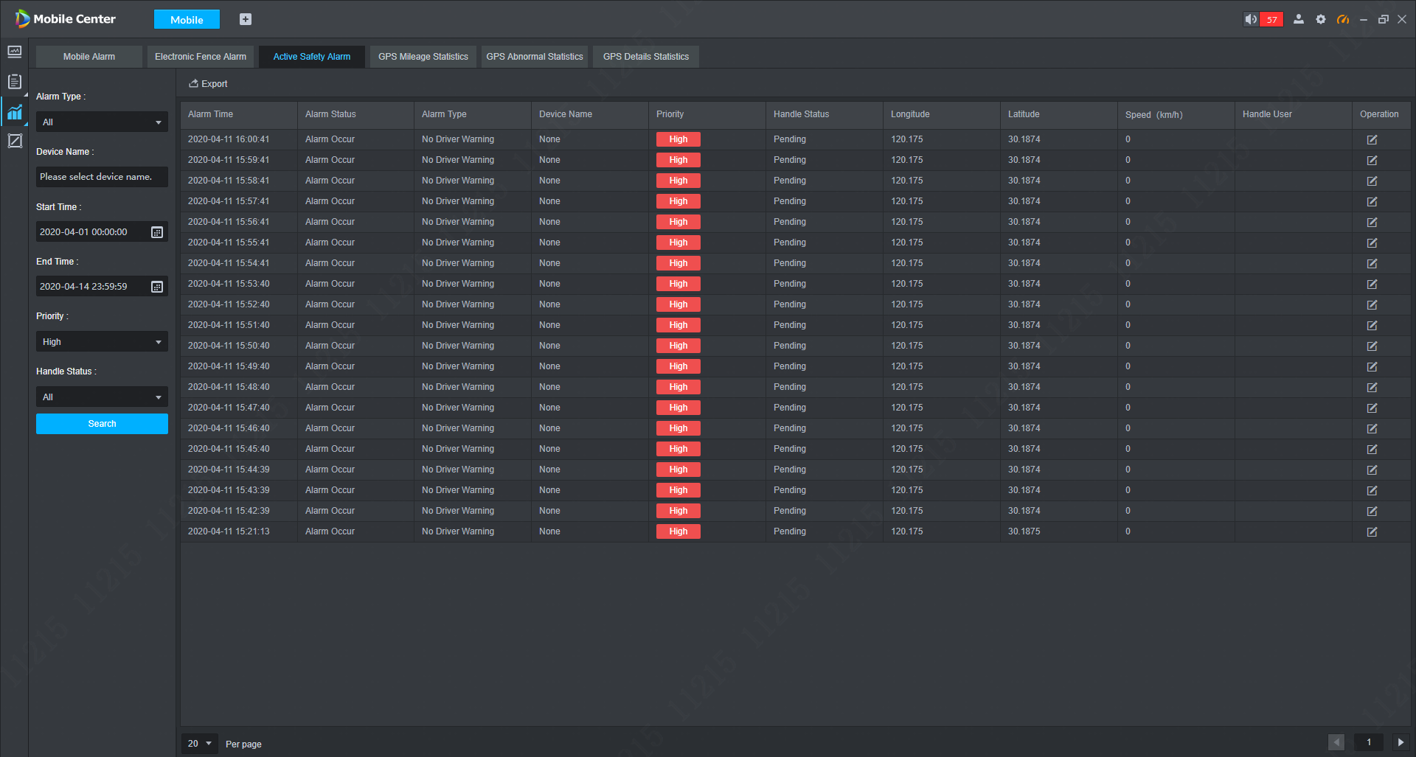
Active Safety management
1. Active Security Alarm Subscription
2. Active Security Alarm Center
Enable indicates whether you need to subscribe to this alarm.
Automatic represents whether the alarm needs to be handled manually.
When an alarm occurs, the Mobile Center will remind in various ways;
Real-time display active safety alarm information;
Query and export the related alarm information;
Notes:
以上功能是对设备配置、报警接入能力的增加。

Slide 21
Monitor Center
0 1
0 2
Real-time View
E-Fence
Video / Alarm / Map
Events handling
Standardize driving behavior
0 4
0 3
Statistic
Investigation
Alarm / GPS
Playback / Track

Slide 22
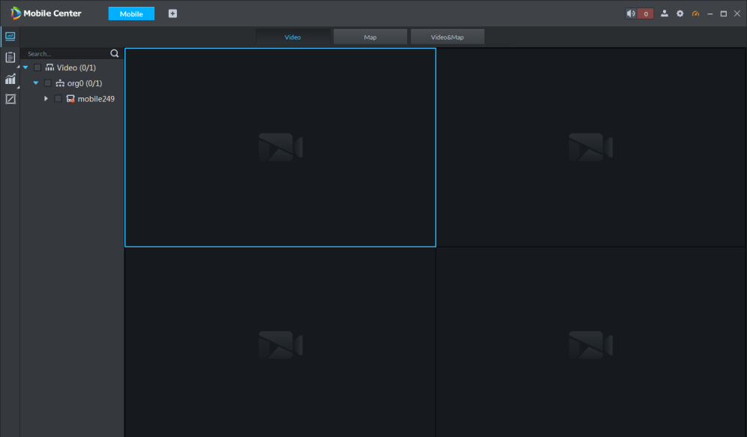
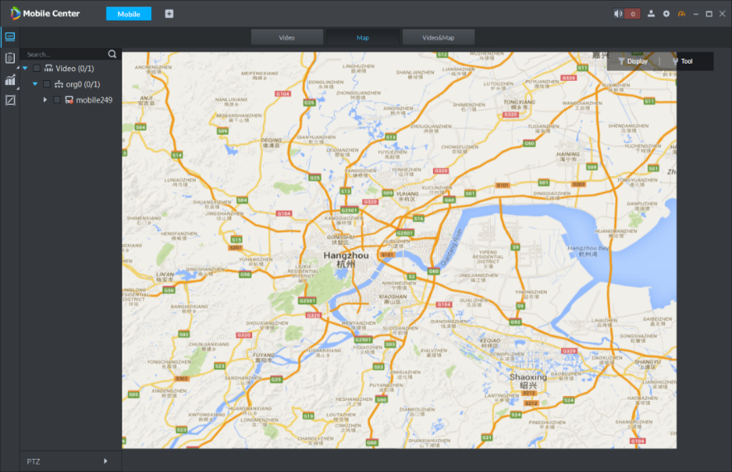
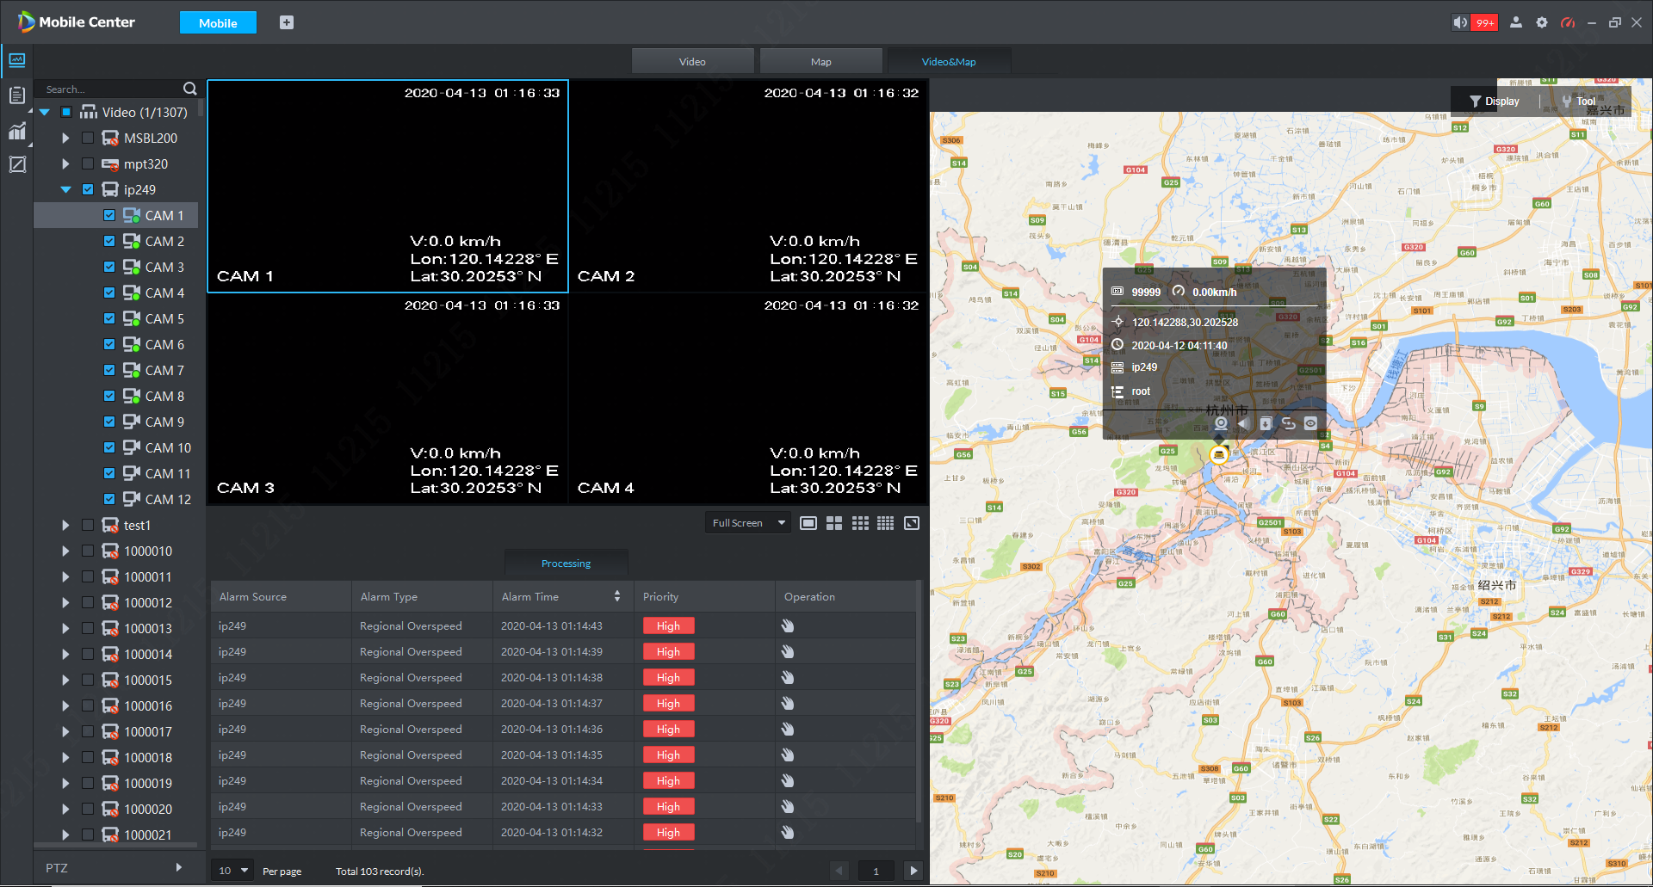
Monitor Center | Live View
Video
Map
Map + Video
Three Modes
Notes:
配合多屏输出，和电视墙，
可以更灵活

Slide 23
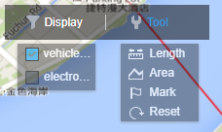
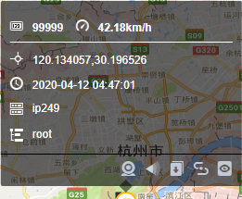
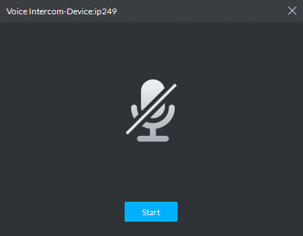

Monitor Center | Live View
Real-time alarm information display:
car alarm, video alarm, E-Fence alarm, active safety alarm
Alarm Icon
Audio Talk
Notes:
在监控中心，通过一个界面，就可以监控所有车辆的情况，包括所有车辆情况、视频和报警信息
在地图上显示所有车辆的位置，对所有车辆进行全面的监控
在有异常情况时，地图上的图标进行闪烁和提醒
通过点击地图上的车辆图标，就可以查看相应的视频
并可以开启语音，和司机进行语音沟通确认

Slide 24
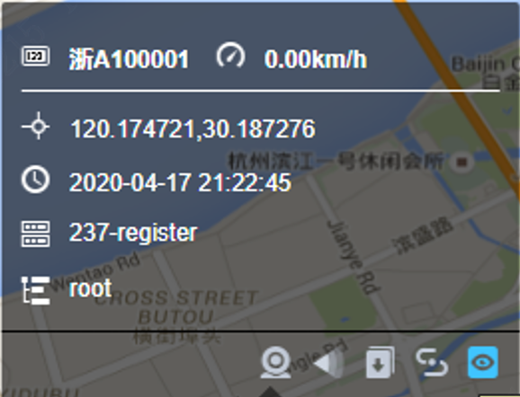
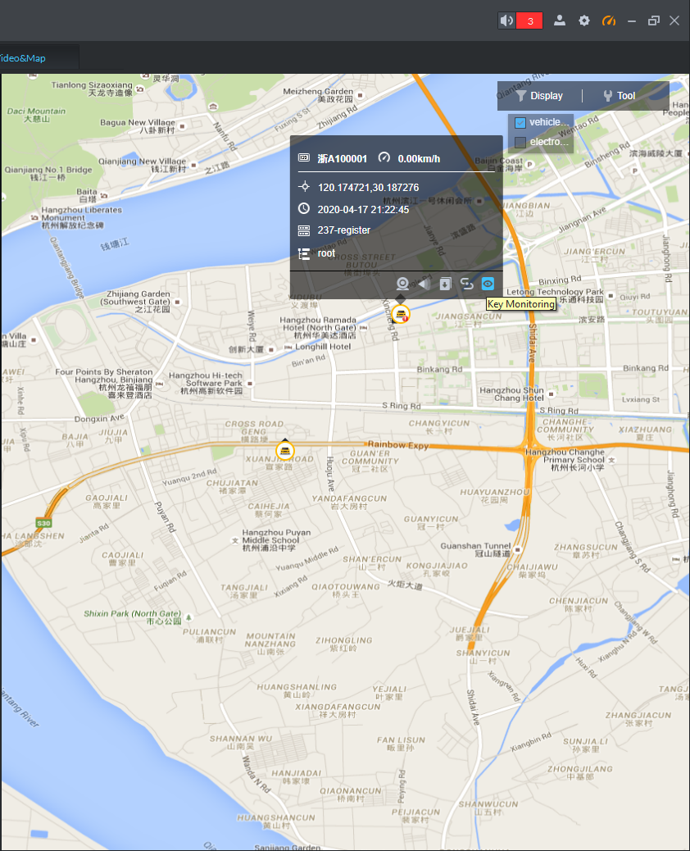
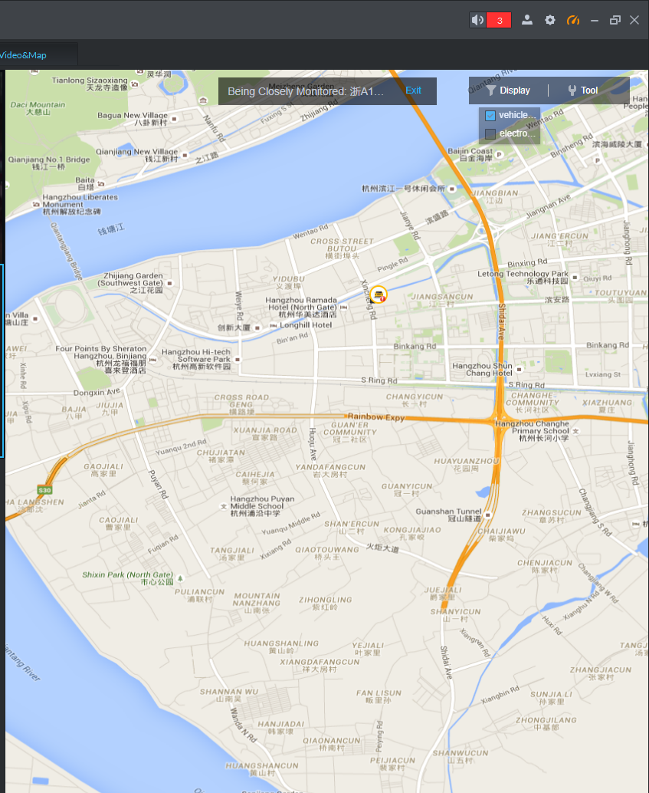
Monitor Center | Key Monitoring
Key Monitoring
For vehicles that need to be focused on, you can use key monitoring. Only key monitoring vehicle are shown on the map.
Notes:
针对需要重点关注的车辆（紧急按钮），可以使用，中心进行调度和协调

Slide 25
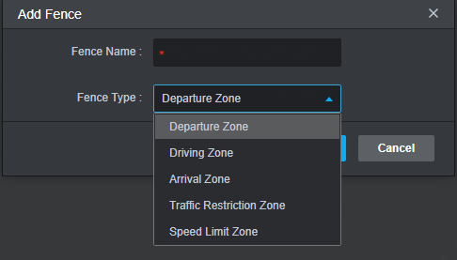
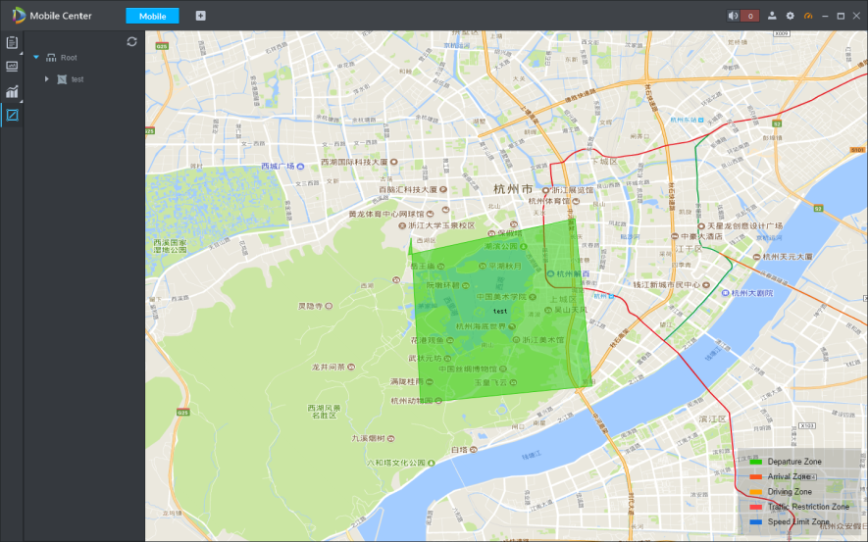
Monitor Center | E-Fence
Mobile Center supports E-Fence set：
  Departure Zone / Driving Zone/ Arrival Zone / Traffic Restriction Zone / Speed limit Zone.
  Bind the electronic fence with mobile device.
When the vehicle is out of the area，Mobile Center will trigger the warning, and pop up an alarm
When the control center get the alarm, they can start audio talk with the driver to know the situation.
Notes:
车辆行驶在路上，车辆现在开到哪里？司机在做什么？
在地图上一直盯着所有车辆肯定是不现实的，如果我们可以对车辆的行驶路径做一些规则设置，一旦车辆偏离规则时，可实时报警，这是不错的方案

Slide 26
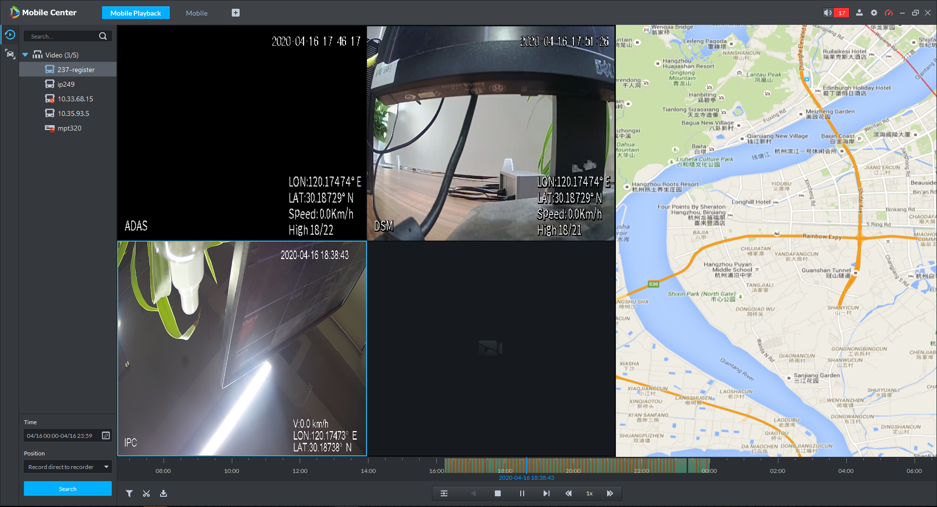
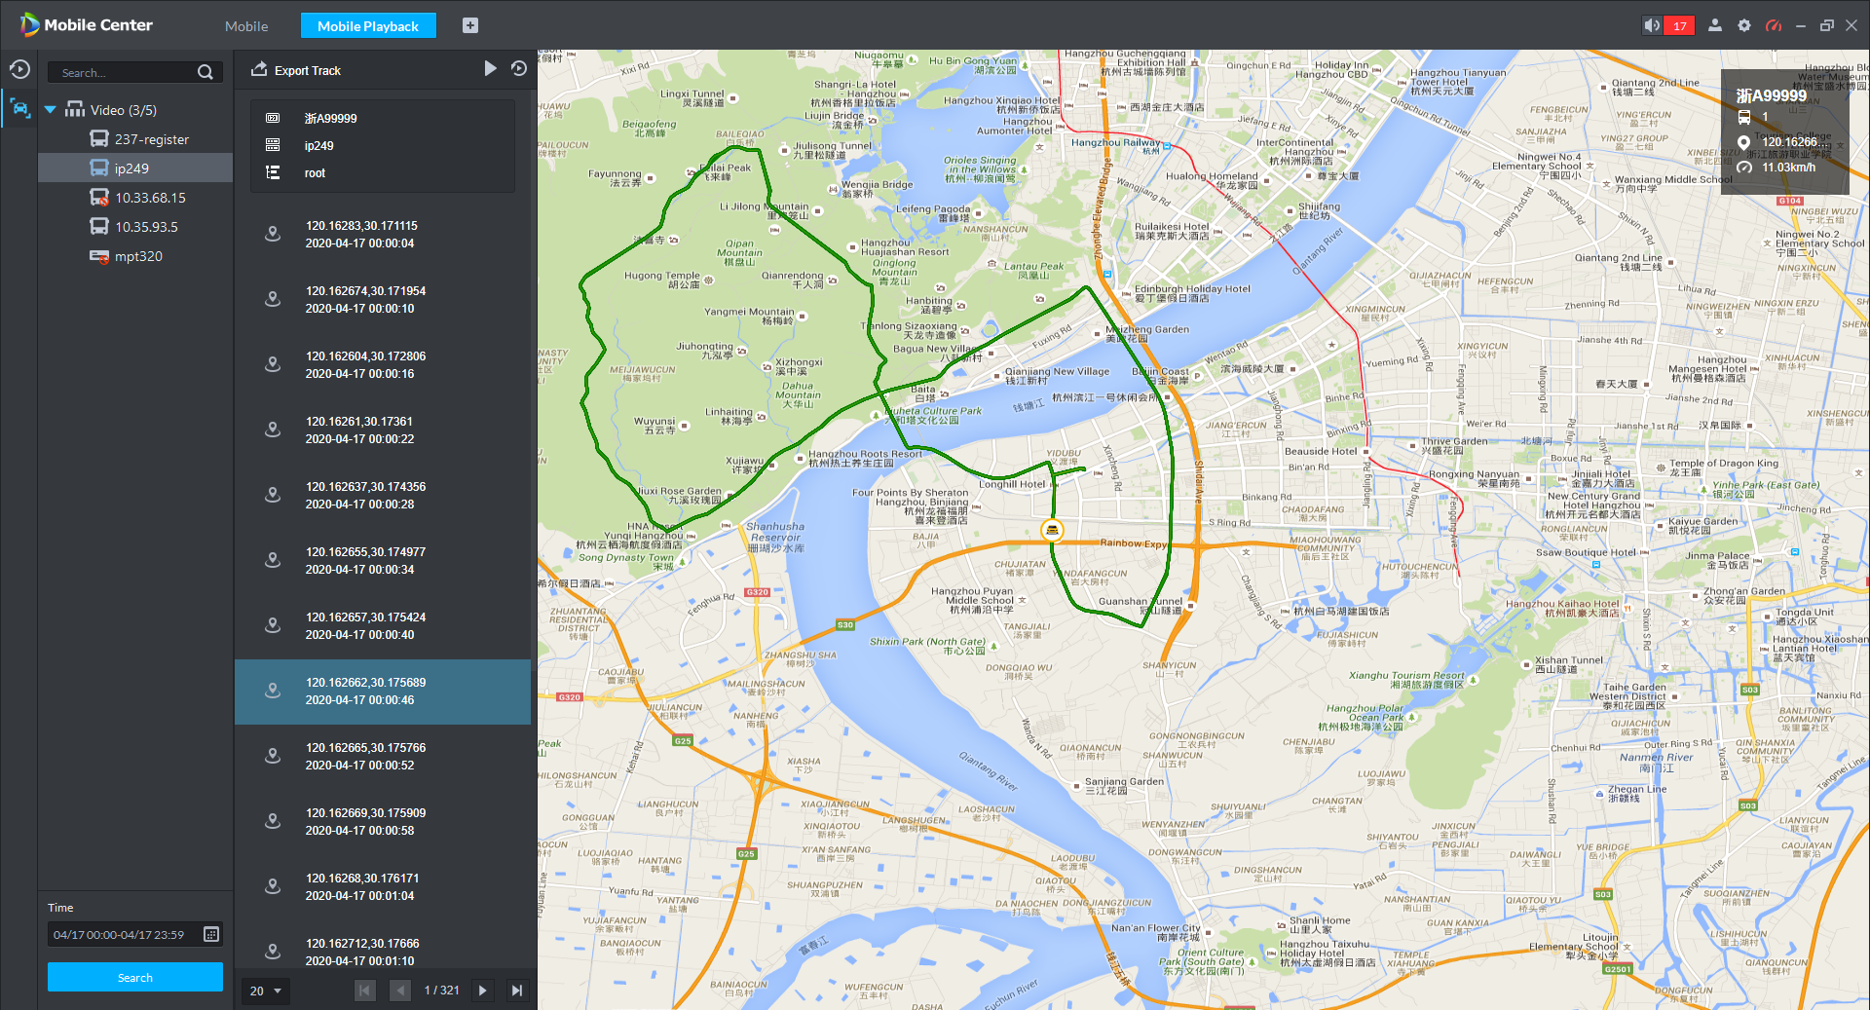

Monitor Center | Investigation
Playback
Historical Track
Easy to get post-event evidences
Supports video query and playback, including MNVR video, central video, alarm video.
At the same time can show historical route of vehicle.

Slide 27

Monitor Center | Vehicle Statistics
Mobile Alarm
Search alarms from mobile device;
Lists alarm history, including device name, abnormal zone info, alarm type, time, location.
E-Fence Alarm
Search E-fence alarm by setting conditions.
Lists alarm history, including device name, abnormal zone info, alarm type, time.
Active Safety Alarm
Search Active safety alarm history, including active safety alarm location, time, alarm type, speed.
GPS Mileage
Search and display the mileage of the different vehicles .
Supports exporting.
GPS Abnormal
Lists abnormal situation, such as Mobile Center has not received GPS info within a certain period of time(hours)
GPS Detail
Lists detail info of the vehicle, including plate No, location, speed, device name, and device ID.

Slide 28
Highlights
/ 04
DISTRIBUTION / HOT STANDBY / SYSTEM BACKUP / RECORDS BACKUP

Slide 29






Distributed System | Up to 10000 channels
Main Server
Sub Server
Sub Server
IPC
MPT
MNVR
IPC
MPT
MNVR
Up to 5 sub servers , 5000 devices, 10000 channels.
Notes:
limit channels
For the operator, it is just one system. no need to access sub servers.
The scale of projects is often different. How to meet the different scale projects. Mobile Center supports distributed system.

Slide 30




Hot Standby
Main Server
Hot standby Server
Database sync
Keep alive
When abnormal behavior is detected on the server, hot-standby server will work instead to ensure the service stability.

Slide 31


System Backup and Restore
Data Backup
Data Restore
Backup
Manual backup
Automatic backup
Restore
Restore from local PC
Restore from server
The system periodically back up setting, organization user, storage plan, device info, alarm scheme and etc. When system data are lost, you can restore system data via backup file.

Slide 32





Backup MNVR Records to Center
TIME
WIFI
EVS
MNVR
ISCSI
Backup
Mobile Center
Center Storage
Edge Storage
During the specified time period, or when the MNVR is connected to the WIFI, Mobile Center will download the video from the front-end MNVR and storage. It will not occupy 4G bandwidth, reduce costs and ensure records safety.
Notes:
For mobile vehicle projects, MNVR is generally connected through 4G and platforms, and the network focuses on ensuring the transmission of key information. Therefore, MNVR is generally used for real-time video storage. During non-operation time, MNVR is connected to WIFI, the platform downloads video from the device side, and records are stored in the center to save bandwidth and also ensure video backup.

Slide 33
Sales Strategy
/ 05
PRODUCT+SERVICE / REMIND.

Slide 34


Sales Strategy
Product
From 64 to 16
Product | Model | Description | PN
Base | DHI-MobileCenter-Base-License | Mobile Center base package license with 16 auto register video channels | 2.9.03.01.10052
Channel | DHI-MobileCenter-Video-Channel | Auto register video channel license(one license per channel) | 2.9.02.07.10004
Customization | CUS-DAE-SOFTPLATFORM-OVERSEA | Custom Development Service | 2.0.03.01.0437
Services
Consistent with DSS series
Basic Technical Support Services
Phone 5*8hours
Email
Software Support & Upgrading Service
3 years free(Baseline)
1 years free( Customization version )
Upgrading service
Custom Development Service
Requirement Design
Development
Test
Remote installation support
Offers the upgrading operation document

Slide 35
Th anks
Mobile Center
www.dahuasecurity.com

